Slide 1
From Data to Value: AI in Serbia's Mass Valuation Landscape

Slide 2
TOPICS
AI
Who?
What?
When?
Mass Valuation Models
Real Estate
Market
AI Innovations
AI
Achievements

Slide 3
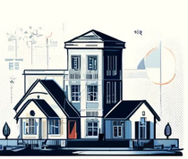
About Republic Geodetic Authority (RGA) of Serbia
Geodetic & Cadastral Services
Licensing & Supervision
Geospatial Data Management

Slide 4
About Republic Geodetic Authority (RGA) of Serbia
Property Mass Valuation & Price Indices
Cartography & Publications
Archival & Information Systems
International Cooperation & Specialized Services

Slide 6
Development Path of Mass Valuaion

Slide 7
Real Estate Price Registry
All transactions in one place!
The Real Estate Price Registry (REPR) was established in 2012
Public access transparency was established in 2014
The E-Desk system was active from July 2018, and by the end 2023, they recorded ~1,500,000 sales in REPR
The REPR is constantly growing

Slide 8
Current Utilizations of Mass Valuation
Real estate value is one of 4 pillars of land administration (UN-GGIM, 2020)
More than 30% of properties within some municipalities were not paying property tax
Mass valuation + geospatial data =
Trend monitoring, growth indicator, stability assessment

Slide 9
REPR & Mass Valuation Users
National Bank of Serbia
Ministries
Local Government
Economists
Investment Sector
Construction Sector
Commercial Banks
Lawyers & Courts
Valuators
Real Estate Agencies

Slide 10
MODEL DEVELOPMENT
Four Key Components to the Model Development Process:
Data Characteristics
Regression Analysis
Creation of Time Variables
Geospatial Data Analysis

Slide 11
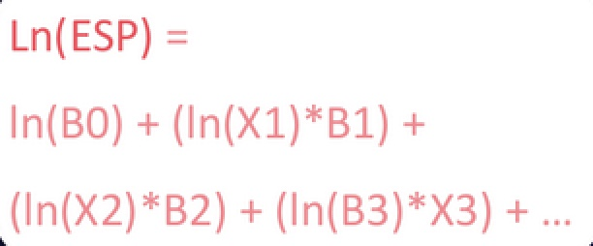
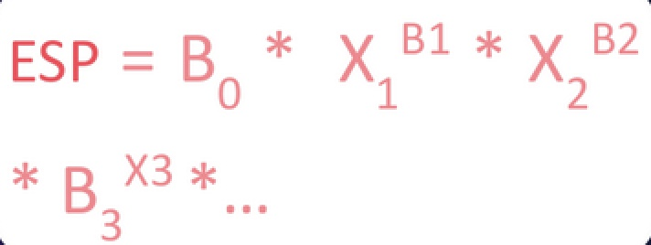
REGRESSION ANALYSIS
Hedonic regression, using least squares
﻿﻿Turning multiplicative into an additive formula structure
﻿﻿Converting the model results back into a multiplicative structure using exponents
﻿﻿Data extraction
Exploratory data analysis and variable transformation
﻿﻿Regression analysis
﻿﻿Creation of time variables
﻿﻿Geospatial data analysis

Slide 12
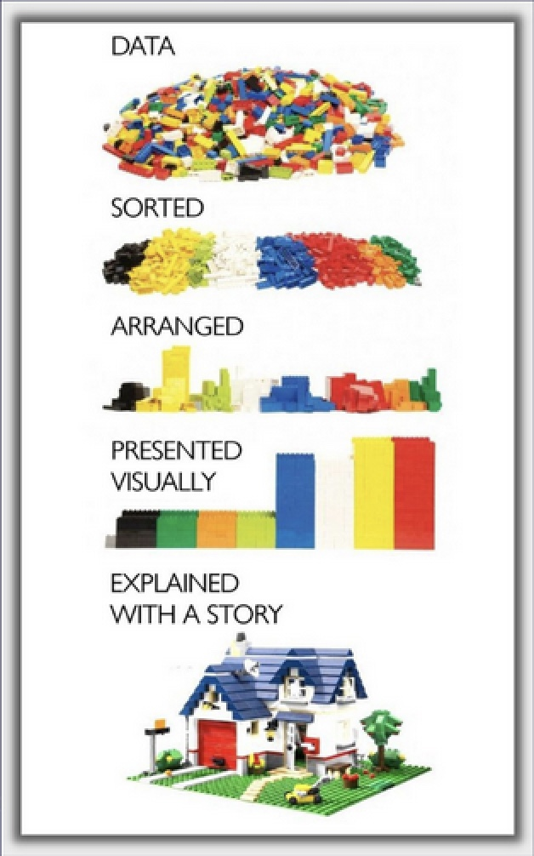
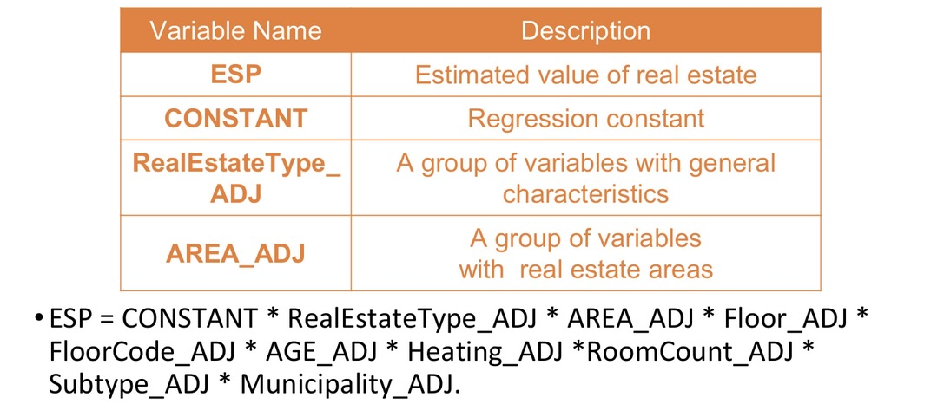
REGRESSION ANALYSIS

Slide 13
MASS VALUATION MODELS

Slide 14
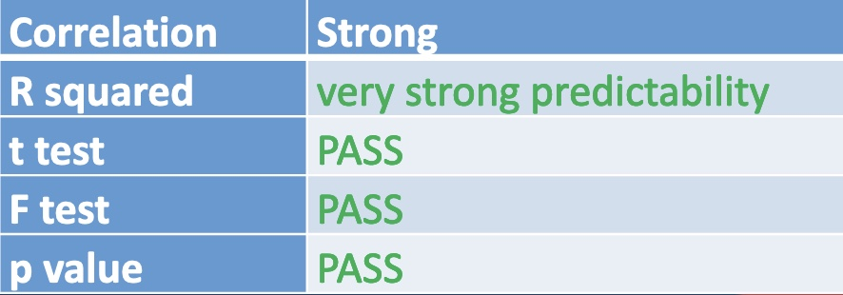
MODEL TESTING
Testing of the RGA valuation results by one of the largest commercial banks was performed on 15,816 appraised apartments for Q3 2023.The average deviation is -1.3%, with a median of -3.3%.Overall, the RGA valuation differs by -3.3% median from the bank's valuation for the same period.
Testing was conducted for the T2 2024 valuation period using data from the valuation database of the National Bank of Serbia for the same period. A total of 1,907 apartments were linked. RGA's valuation values are on average 4.7% lower compared to the valuations made by appraisers for credit requirements in T2 2024.

Slide 15
Values free for public!
In June 2024 RGA published data on website the estimated values ​​of all condominiums (majority of people in big cities live in, buy and sell condominiums),
all garage spaces and
apartments in family residential buildings.
For the first time in history, every citizen of Serbia can now check the estimated value of their property completely free of charge.
It is more then 1 000 000 proprieties

Slide 16
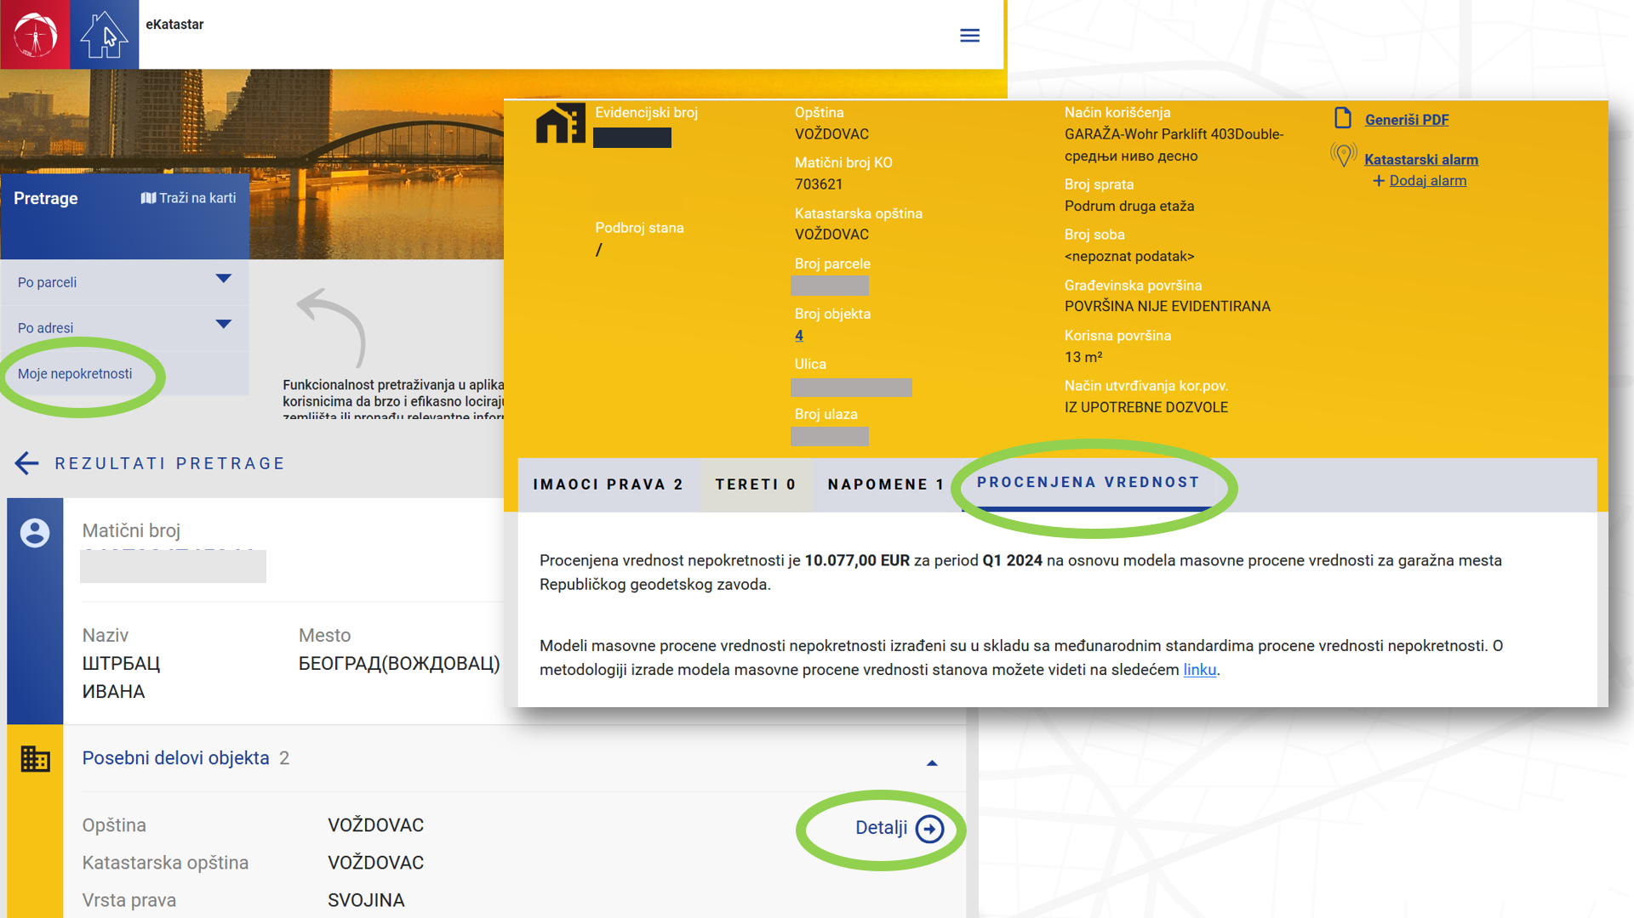

Slide 17
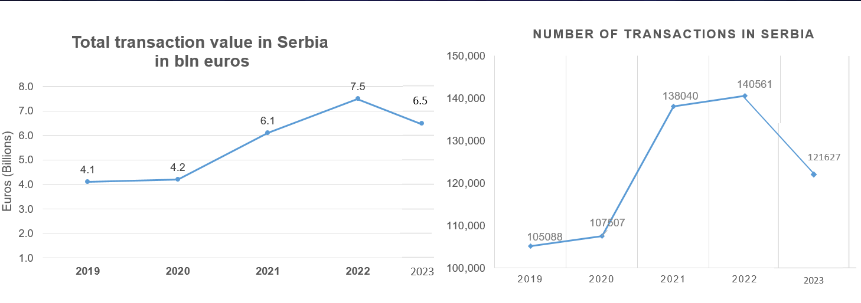
Real Estate Market Trends in Serbia

Slide 18
Residential Real Estate Price Indices In Europe, Т1 2019=100
RGA Index Rate of Change of Index
(Year Over Year)

Slide 19
Machine Learning & AI. Mass Valuation
Primary data sources
Secondary data sources
Real Estate Price Registry (REPR)
Real Estate Cadastre
Condo Registry
Local Tax Administration
Geosrbija

Slide 20
AI APLICATION IN MASS VALUATION Data Collection Process

Slide 21
PROBLEMS
Documents received as scanned pictures
A non-standard approach
Manual input for statistical records

Slide 22
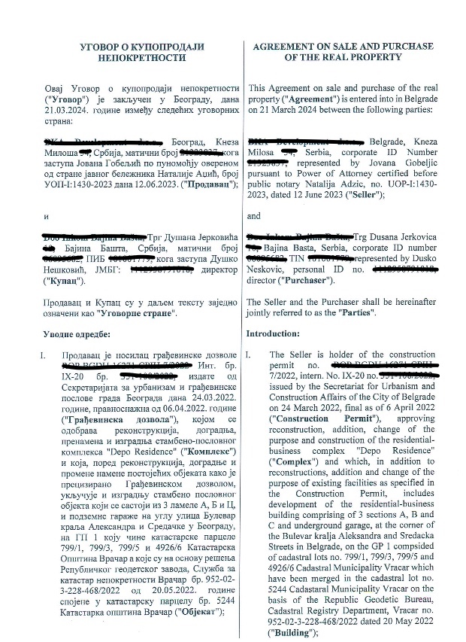
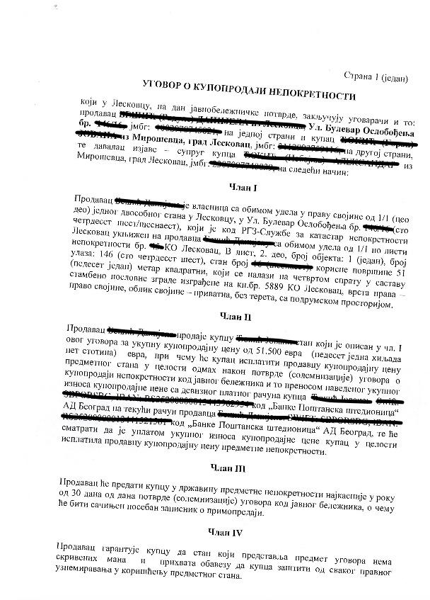
EXAMPLES

Slide 23
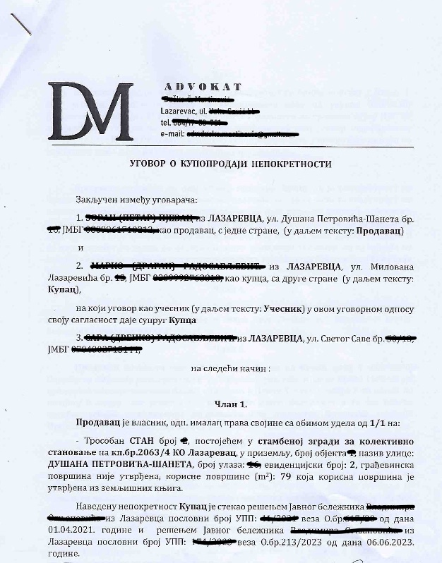
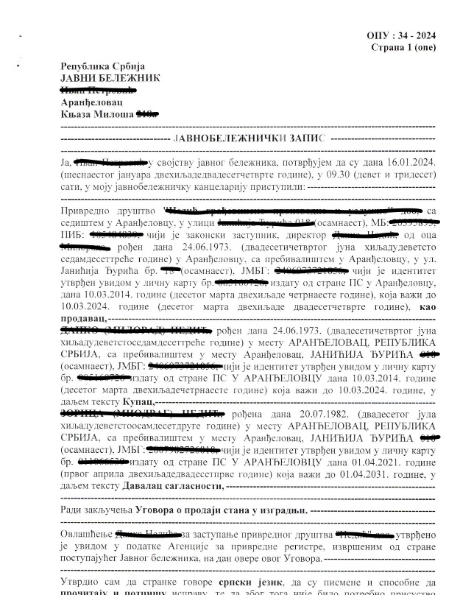
EXAMPLES

Slide 24
EXAMPLES
Approximately 600 cases per day
One person can handle 30-50 regular cases per day

Slide 25
STAGES OF PROCESSING
1. Converting Images to Text
2. Extracting Relevant Information from Text
3. Text Processing and Analysis

Slide 26
OPTICAL CHARACTER RECOGNITION
Challenges:
Unreadable sections – obscured by shadows, poor lighting,
or angles
Language Variability – documents occasionally have other languages – English usually
Mixed Scripts – documents have both Serbian scripts (latin and cyrillic)
Unusual Formatting and Symbols – information displayed with codes like “Pr+4+Po+Pk”

Slide 27
OPTICAL CHARACTER RECOGNITION
OCR configurations:
1. Cyrillic Default – primary recognition of Cyrillic script
2. Latin as Subscript – secondary recognition support for Latin script
3. Fine-tuned Model – custom-trained OCR for complex cases
4. Whole Page OCR – processes entire document page to fill in missing or unreadable parts

Slide 28
OPTICAL CHARACTER RECOGNITION
Pre-trained:
BCER – 7.136
BWER – 34.424
Data + Images
Fine tuned:
BCER – 2.374
BWER – 9.475
Image augmentations

Slide 29
LARGE LANGUAGE MODEL
Challenges:
Huge amount of information – large context from both documents and instructions
Precise structured output – essential for database creation
Conflicting information – conflicting or overlapping information regarding the same data points
Precise categorization – ensuring alignment with established classifications

Slide 30
LARGE LANGUAGE MODEL
Data extraction
Model 1: Contract Subjects Extraction
Model 2: Parties & General Information Extraction

Slide 31
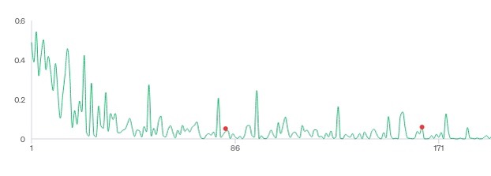
LARGE LANGUAGE MODEL
Training set: 200 documents
Emphasis on careful and diverse selection
Valuation score
Structure output learning curve
Patterns recognition learning curve
Document number

Slide 32
PROCESSED DATA STRUCTURE
5 database tables:
Document – 13 columns (general information)
Entities – 13 columns (parties involved)
Parcel – 9 columns (land details)
Object – 15 columns (property structure)
Separate Unit – 11 columns (individual property units)

Slide 33
TABLE EXAMPLES
Document
Object
Separate unit

Slide 34
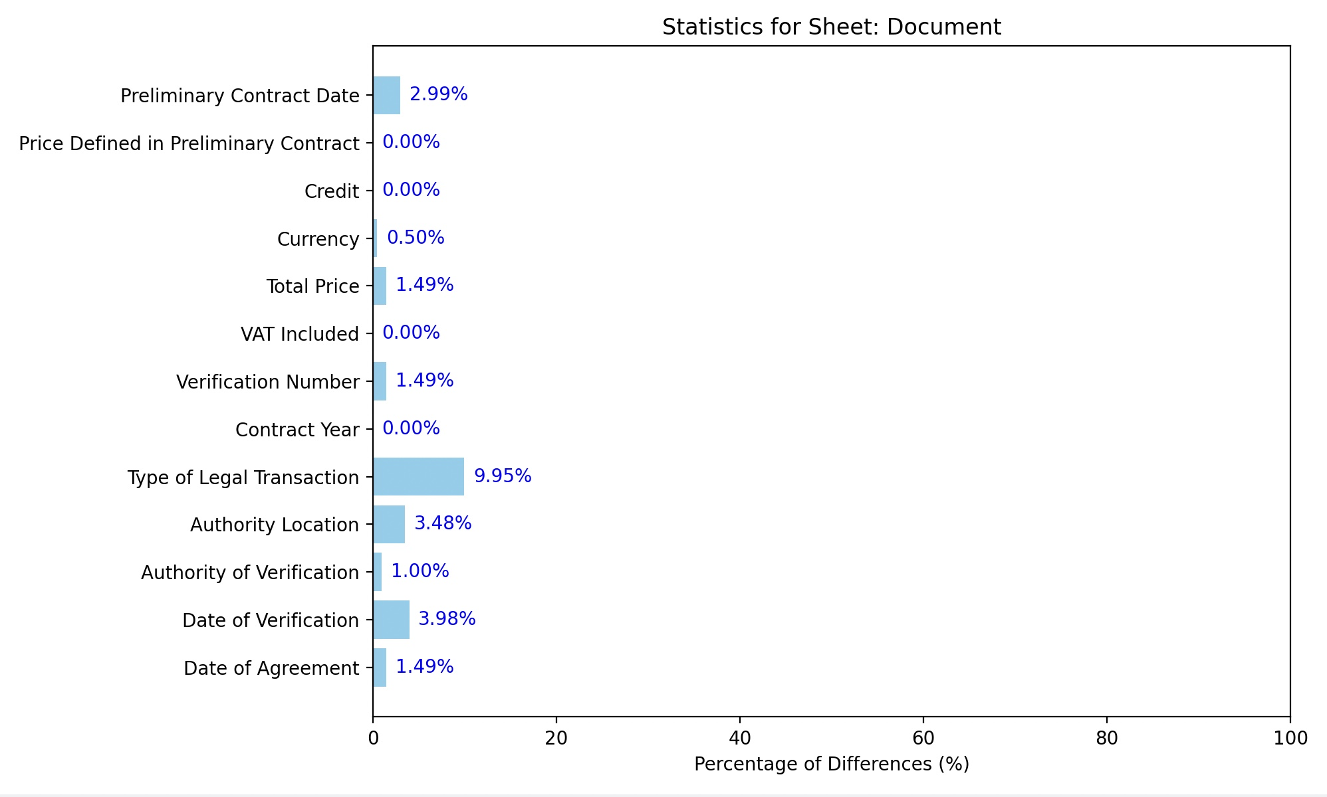
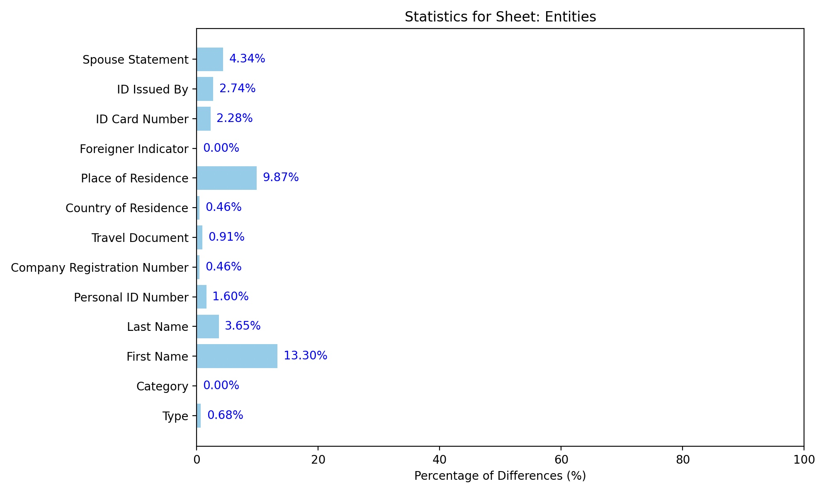
RESULTS

Slide 35
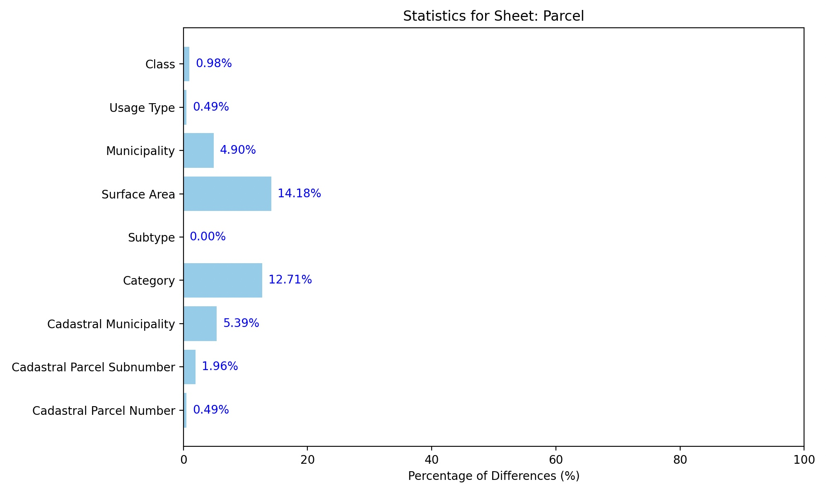
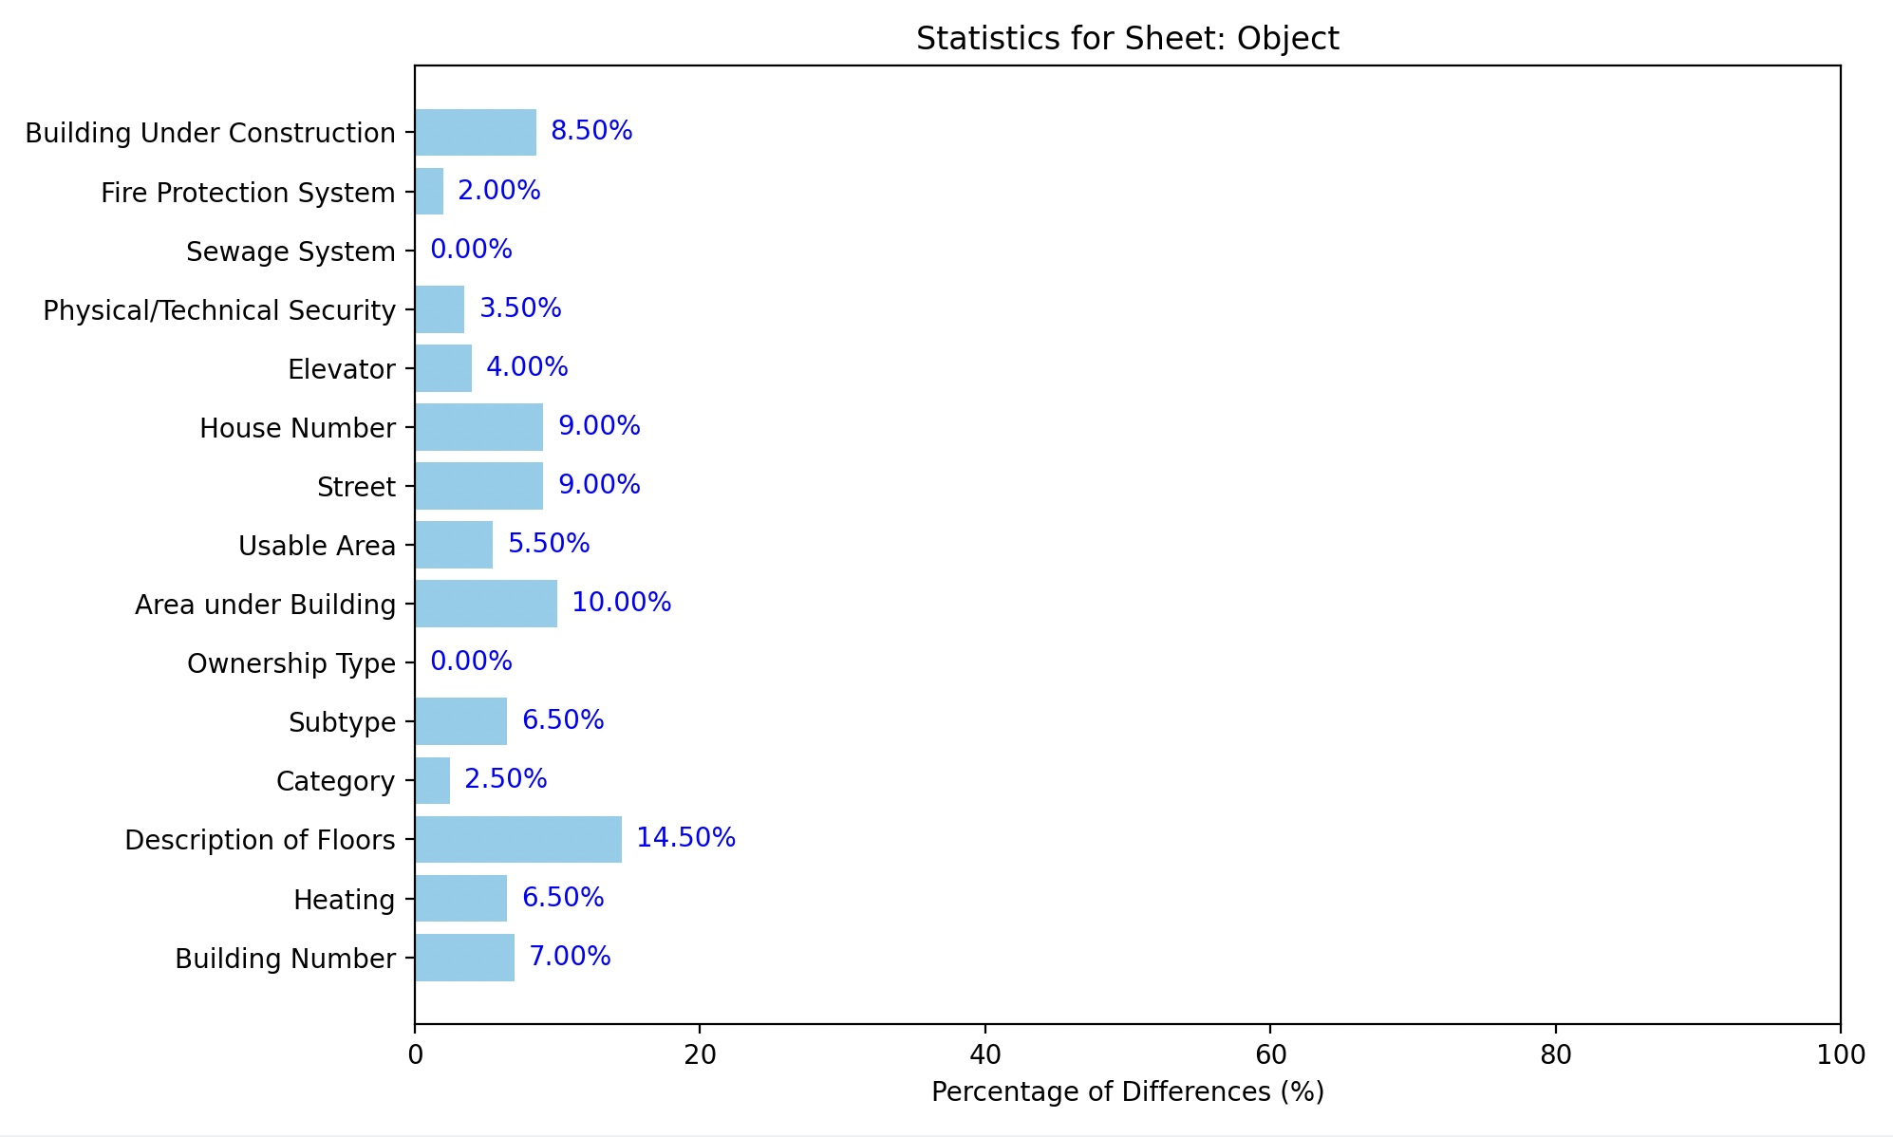
RESULTS

Slide 36
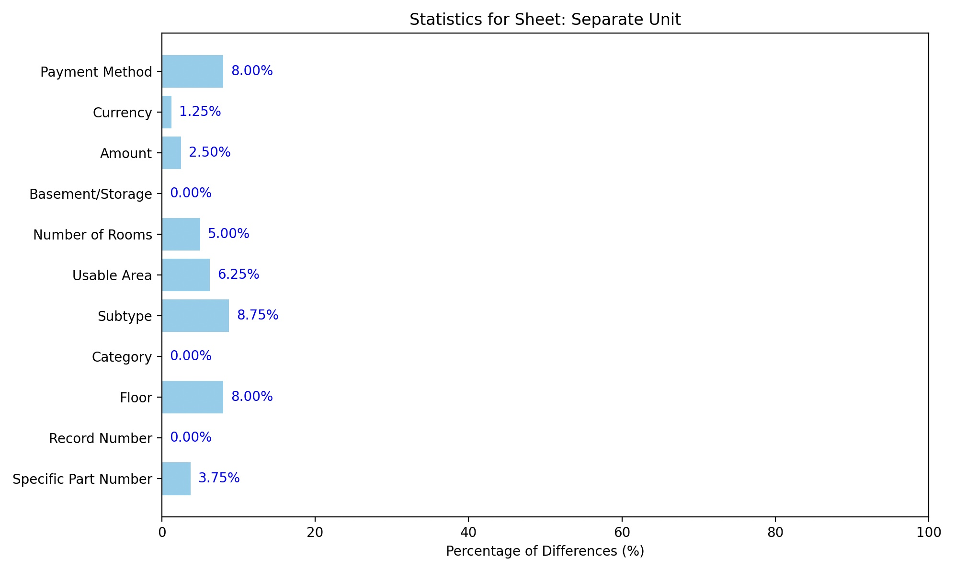
RESULTS

Slide 37
RESULTS
Documents with zero errors:
Across all tables – 27%
Document table – 82%
Entities table – 57%
Parcel table – 76%
Object table – 60%
Separate Unit table – 63%
Human oversight remains essential for ensuring accuracy!

Slide 38
Future steps
Improve all MV models and AI models
Implement AI into system
Property tax policies and regulations – need for a change
Implementation of new mass valuation information system
Establishment of South East Europe IAAO (SEE)
Future steps

Slide 39
THANK YOU FOR YOUR ATTENTION

